Slide 1
CSE 321 Computer Networks July 2018 Term
Class 3: Layered Protocol Architecture
Khaled Mahmud Shahriar
Assistant Professor, Dept. of CSE, BUET khaledshahriar@cse.buet.ac.bd

Slide 2
Why Layering
A complex task is broken into subtasks: modular design
Each subtask is implemented separately as a layer, arranged in a vertical stack
Each layer performs a related subset of the functions required to communicate with another system.
It relies on the next lower layer to perform more primitive functions and to conceal the details of those functions.
It provides services to the next higher layer.
Layers should be defined so that changes in one layer do not require changes in other layers.
So, instead of using a single complex protocol, it’s more flexible to implement a stack of protocols!
Reduce the design and development workload significantly!

Slide 3
Protocol Hierarchies
Protocols are stacked vertically as series of ‘layers’.
Each layer offers services to layer above, shielding implementation details.
Layer n on one machine communicates with layer n on another machine (they are peer processes/entities) using Layer n Protocol.

Slide 4
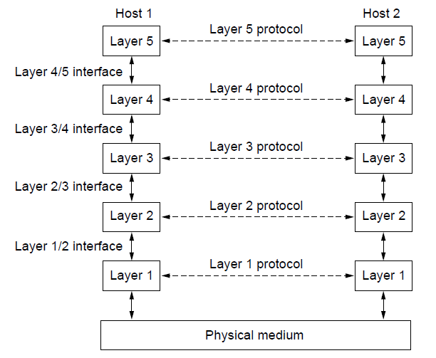
Protocol Hierarchies
Layers, protocols, and interfaces.

Slide 5
Virtual & Actual Communications
Important to understand difference between:
virtual and actual communications,
protocols and interfaces.
Peer processes ‘think’ of communications as being ‘horizontal’ using protocol.
Actual communications is via interfaces (and the physical communications medium).
Peer process idea is key to network design.

Slide 6
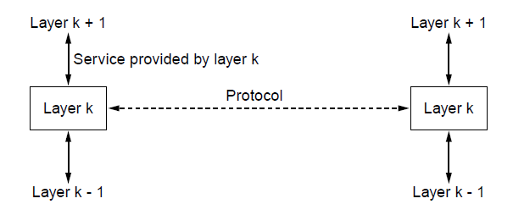
The Relationship of Services to Protocols
The relationship between a service and a protocol.

Slide 7
Examples of Service
Addressing
Routing
Error control
Reliability
Flow Control
Multiplexing
Fault tolerance
Scalability
Quality of service
Security

Slide 8
Vertical Stack
Application A
Application B
Application C
Module A
Module B
Module C
Application developers
Module T
Operating System
Module I
Module N
Hardware
can be replaced by other modules
Module P
Module W

Slide 9
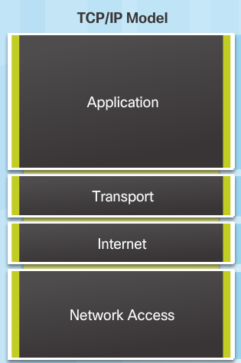
TCP/IP protocol stack
application: supporting network applications
FTP, SMTP, HTTP
transport: process-process data transfer
TCP, UDP
network: routing of datagrams from source to destination
IP, routing protocols
link: data transfer between neighboring network elements
Ethernet, 802.111 (WiFi), PPP
physical: bits “on the wire”

Slide 10
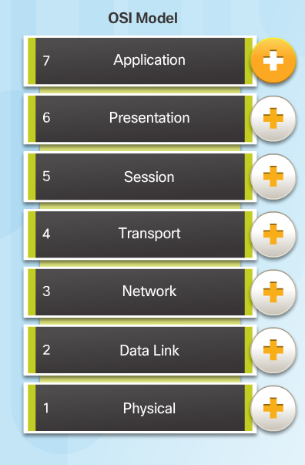
ISO/OSI reference model
presentation: allow applications to interpret meaning of data, e.g., encryption, compression, machine-specific conventions
session: synchronization, checkpointing, recovery of data exchange
Internet stack “missing” these layers!
these services, if needed, must be implemented in application
needed?

Slide 11
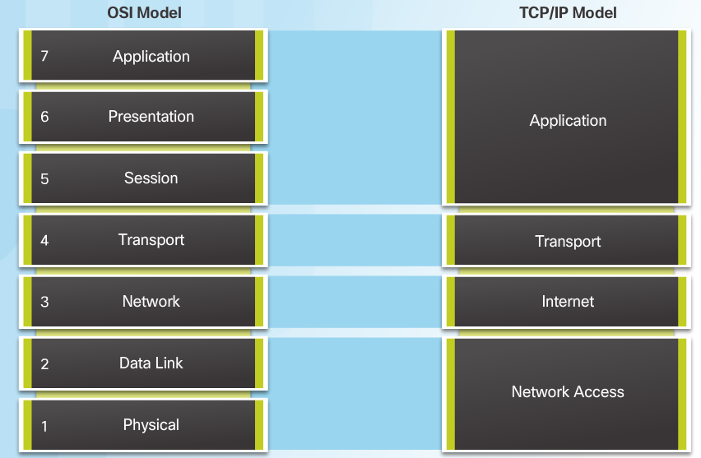
OSI Model and TCP/IP Model Comparison
In the OSI model, the network access layer and the application layer of the TCP/IP model are further divided to describe discrete functions that must occur at these layers.
Notes:
3.2 – Network Protocols and Standards
3.2.4 – Reference Models
3.2.4.4 – OSI Model and TCP/IP Model Comparison

Slide 12
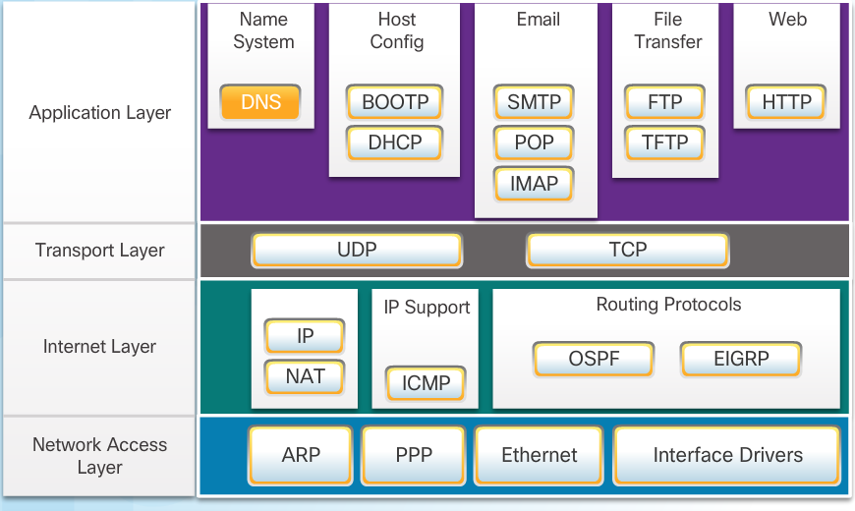
TCP/IP Protocol Suite
Notes:
3.2 – Network Protocols and Standards
3.2.2 – Protocol Suites
3.2.2.3 –TCP/IP Protocol Suite

Slide 13
Example: File Transfer
Host A
Router
Host B

Slide 14

Encapsulation
source
message
M
application
transport
network
link
physical
segment
H_{t}
M
H_{t}
datagram
H_{n}
H_{n}
H_{t}
M
frame
H_{l}
H_{n}
H_{t}
M
link
physical
switch
destination
H_{n}
H_{t}
M
network
link
physical
M
application
transport
network
link
physical
H_{l}
H_{n}
H_{t}
M
H_{n}
H_{t}
M
H_{t}
M
H_{n}
H_{t}
M
H_{l}
H_{n}
H_{t}
M
router

Slide 15
Encapsulation in the TCP/IP Suite

Slide 16
Example: Web Browsing
Host A
Host B
Application Layer
Application Layer
HTTP Message
Transport Layer
Transport Layer
TCP Packet
Router
Internet Layer
Internet Layer
Internet Layer
IP Datagram
IP Datagram
Network Layer
Network Layer
Network Layer
Ethernet
Frame
Ethernet
Frame
Physical Network
Physical Network

Slide 17
Thank You

